Slide 1
Incident Reporting

Slide 2

Definitions
An incident is any unplanned event that has resulted in, or could have resulted in, injury or ill health to people, damage to or loss of property, plant or materials. This definition includes any accident which has resulted in a personal injury.
A Near Miss is an event that could have lead to harm but on this occasion, as a result of chance or intervention, did not.
Reporting a near miss is just as important as reporting an actual incident. Near misses indicate difficulties that may be due to incorrect or missing procedures being in place. It is important that these are recorded. Although staff may only see an isolated incident within their area, this may have wider implications

Slide 3
Why should you report an Incident or
Near Miss
Reporting incidents at work is crucial so the organisation can take steps to ensure that a similar accident should not happen again.
Understanding and learning from incidents is an important part of risk management. The reporting of incidents allows the organisation to monitor its safety performance and by analysing the information from incidents, ensures that suitable steps are taken to remove or reduce any future risk and minimise the chance of a similar incident occurring in the future.
Reporting incidents also increases the likelihood that any patterns are identified and can be corrected before they develop into more serious ones.
Reporting a ‘near miss’ is as important as reporting an incident that actually occurred and caused harm. Although a ‘near miss’ did not cause harm, it indicates an issue and which if not managed effectively, may have the potential for an incident to occur in the future.
Reporting incidents and near misses are important and whilst staff may only see it as an isolated incident within their area, there may be wider implications for the organisation.

Slide 4
Incident Reporting and Monitoring
CRGPA uses Datix to record all incidents, near misses, Compliments and Complaints.
Datix can be accessed via the link on the home page of Team Net however it is recommended that you save the URL on your favourites bar to make access quicker and easier
Timescales to Report an Incident
– All incidents to be recorded within 1 working day of discovery,
– Investigation to commence within 2 working days of notification
– Closure – Low risk incidents should be closed within 2 working days, medium risk 5 working days and high/Serious risk within 40 working days
Monitoring
All incidents are reported to Safety and Quality Forum and Committee monthly.
All ATP incidents are also reported to the CCG monthly

Slide 5
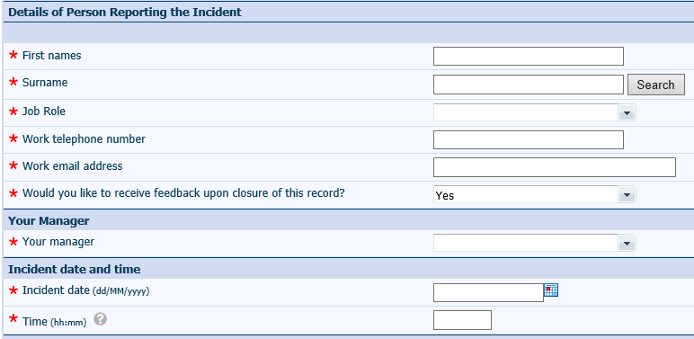
Entering an Incident
* indicates mandatory fields
As the reporter of the incident enter your details here.
  If you have previously entered an incident type surname and search to populate the form
Select your manager from the drop down box.
This is the date and time of the incident, not the date and time you are adding it to the system. Click the calendar icon to open the calendar to help select date.

Slide 6
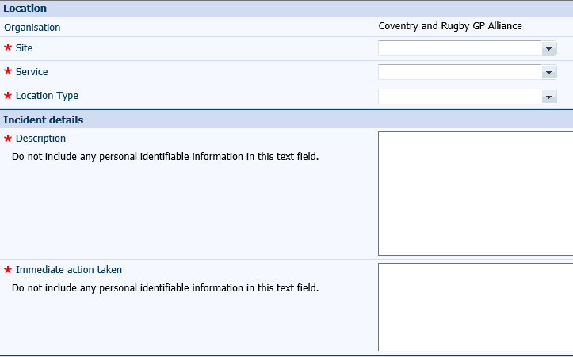
Entering an Incident
Click on the Drop down Boxes to Select correct option
Enter the details of the incident
  Do not include any personal identifiable information
  Add as much detail as you can
Document the immediate actions you took
  Do not include any personal identifiable information

Slide 7
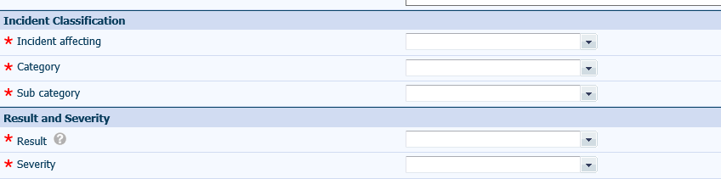
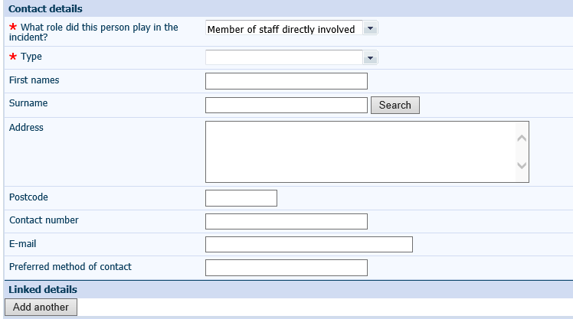
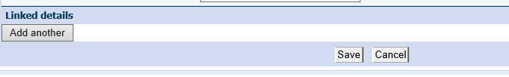
Entering an Incident
Click on the Drop down Boxes to select who was affected by the Incident, result of the incident and severity.
Click on the Drop down Boxes to enter the details of all persons involved in the incident
If you need to add more than one person’s details click Add another – this will duplicate and add an additional Contact Detail section
When you have completed all sections of the form, select save to submit.

Slide 8

Any Questions?
If you require any assistance or have any queries please contact your line manager

