Slide 1

Internal & External Resources for Speaking Up within CRGPA
Working title

Slide 2

Why is it important to speak up?
There are many benefits with speaking up and addressing any problems you may face within the organisation, for example;
Creating a healthy and positive working environment for everyone.
Reduce stress and prevent any toxic elements occurring.
Providing a safe space for you to have your voice heard.
Building Trust
Enhancing Team Collaboration
Strengthening Leadership and Management
Boost Morale and Engagement

Slide 3
Internal Recourses
Line Managers:
Your line manager should be your first point of contact. They are here to provide guidance, support, and direction. Equipped with essential knowledge, they can signpost you to helpful resources and provide relevant information based on your situation.
What if Your Line Manager Is the Concern?
If your concern involves your line manager, there are alternative avenues for support:
Safety Team - Contact the safety team at crgpa.safety@nhs.net. They can direct you to useful resources and assist with reporting any incidents.
EDI Lead - Equality, Diversity and Inclusion Lead, is a role focused on ensuring fairness, inclusivity, and equity within an organisation or community
Staff feedback / Suggestion boxes – Staff feedback (anonymous and non-anonymous options) can be located on Staff Zone, while suggestions boxes can be located in your working environment.
Freedom to Speak Up Guardians – FTSUGs are here to provide a safe space for you to express any concerns you may have with your working environment.
Management - If necessary, escalate your concerns to senior management - those overseeing your line manager. They are there to provide solutions and address any challenges you may be facing.
Human Resources (HR) - If you feel uncomfortable speaking with your manager, or if your concern is more serious, you can reach out to our HR team. They are skilled at handling sensitive issues and can provide confidential support.
Employee Assistance Program (EAP) - For personal concerns or if you need someone to talk to, our EAP offers confidential counselling and support services.
Trusted Colleagues - If you feel comfortable, discussing concerns with a trusted colleague can provide perspective and support.
Notes:
EDI Lead
Staff feedback / suggestion boxes
An anonymous message service on Company website
Union Representatives (not sure though, if it is legally required / viable / recommended in our case)
Freedom to Speak Up Guardians (the details of which have been covered on slide 6 already)

Slide 4

Internal Recourses
MHFAiders:
At our organisation, MHFaider play a vital role in promoting mental well-being and offering peer-to-peer support. As trained mental health advocates, they provide a confidential, approachable space for employees to discuss concerns, seek guidance, and access useful resources.
Through their training, they are equipped to offer practical advice, direct colleagues to appropriate support services, and promote overall mental health awareness, ensuring that mental health is treated with the same importance as physical health.
Our MHFAirders at CRGPA
  Mary Brannigan - mary.Brannigan@nhs.net
  Debbie McGinty - debra.mcginty@nhs.net
  Helen Elsaghir - helen.elsaghir@nhs.net
  Charlotte Kelly - charlotte.kelly36@nhs.net
  Rebecca Haughton - rebecca.haughton2@nhs.net

Slide 5

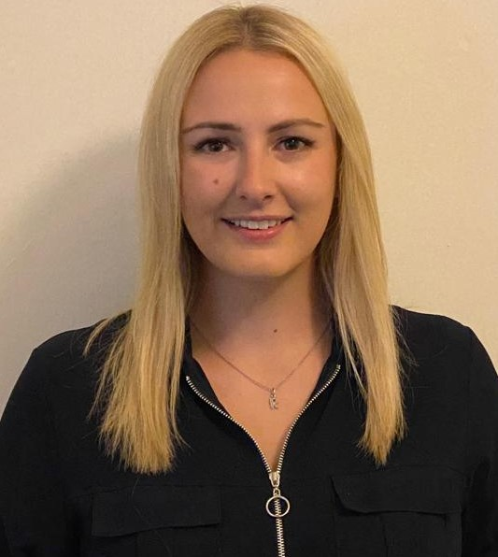
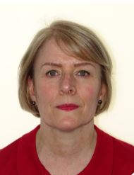

Internal Recourses
Freedom to Speak up:
At Coventry and Rugby GP Alliance, we believe that a healthy and open work environment is essential for our collective success. Your voice is important, and we encourage you to speak up if you have any workplace concerns, whether they relate to safety, team dynamics, processes, or anything else affecting your work experience.
Here are a few examples of concerns that staff can speak up about include (but are not limited to):
• A way of working or a process that isn’t being followed.
• You feel you are being discriminated against.
• You feel the behaviours of others is affecting your wellbeing, or that of your colleagues or patients.
• Unsafe patient care.
• Unsafe working conditions.
• Inadequate induction or training for staff.
• Lack of poor response to a reported safety incident.
• A bullying culture.
• Suspicions of fraud.
You can contact one of our Freedom to Speak Up Guardians:
Rebecca Haughton
Rebecca.haughton2@nhs.net
Patricia Marson
Patricia.marson1@nhs.net
TH –Maisun Elftise
pcftsu.guardian@nhs.net

Slide 6
Datix - reporting incidents and complaints
Reporting incidents, whether they’ve happened or were narrowly avoided, is essential to improving workplace safety. Each report helps our organisation identify potential risks and take action to prevent similar events in the future. Near misses are especially valuable, as they often highlight gaps in procedures or systems that need attention. Recording these events ensures we can learn and improve proactively.
It is easy to submit a report onto Datix. However, we must ensure that you enter as much detail as possible into your submission to ensure that our Safety and Quality Forum and Committee have all the necessary information to review and proceed with the correct precaution.
Timescales to Report an Incident
– All incidents to be recorded within 1 working day of discovery,
– Investigation to commence within 2 working days of notification
– Closure – Low risk incidents should be closed within 2 working days, medium risk
5 working days and high/Serious risk within 40 working days
Submission Process
Once your incident or complaint is submitted through Datix, it is reviewed by the Safety Team and discussed during the weekly Incidents and Complaints meeting, where appropriate solutions are identified and actioned

Slide 7
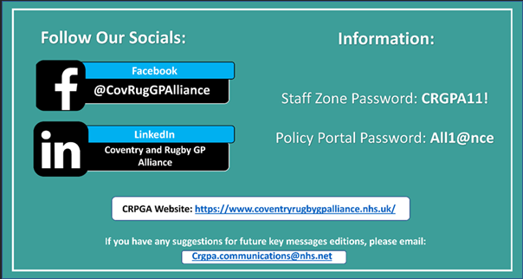
Internal Recourses
Staff Zone
Staff Zone is an exclusive section of the CRGPA website just for staff members. Here you can access a large range of information from policy documents to feedback and staff benefits. This is your go to stop for all the information you’ll need to know about working here at CRGPA.
What is stored on Staff Zone:
Useful links to many different resources
Staff communications (Feedback)
Employee Handbook
Health and Wellbeing section with links, services and advice
How to access Staff Zone:
To access Staff Zone, visit the CRPGA website and scroll down to the bottom where the Staff Zone link will be. You’ll need to enter a password to access Staff Zone which is CRPGA11! For everyone who may not remember it is displayed in the biweekly key messages.
Key Messages Tab

Slide 8

External Resources
VIVUP:
NHS staff can access a free service offering dedicated mental health and wellbeing support. Whether you're facing challenges at home, at work, or with your finances, expert guidance is available to help. It's a trusted and valuable resource designed to support you both personally and professionally.
Speak in confidence to fully qualified counsellors and support specialists 24/7, 365 days a year to discuss any emotional, personal or work-related issues. - 0330 380 0658
To access and sign up to VIUVP visit our Health and Wellbeing page on Staff Zone for more details on how to create an account.
What VIVUP can offer:
Expert help and guidance.
24/7 365 days a year support.
Support improved mental health through access to counselling and 24/7 EAP support.
Wellbeing resources.
Proactive mental, physical, and financial health management.

Slide 9
External Resources
Support networks:
Mind UK - Across England and Wales; Mind UK is making mental health something people talk about every day. We speak out against unfair treatment in healthcare, at work, and in the law - things that make life harder for people with mental health problems.
  If you or someone you know is in a crisis, you can get help here
  Call for support: 0330 102 1234.
  Text 86463
Rethink Mental Illness - works to help everyone affected by severe mental illness, such as schizophrenia and bipolar disorder, recover a better quality of life. It provides effective services and support and campaigns for change through greater awareness and understanding.
  Website: www.rethink.org
  National advice service: 0300 5000 927 (open 9:30am to 4pm, Monday to Friday)
  Email: advice@rethink.org
Samaritans - Available 24 hours a day to provide confidential emotional support for people who are experiencing feelings of distress, despair or suicidal thoughts.
  Website: www.samaritans.org
  Helpline: 116 123 (free to call from within the UK and Ireland), 24 hours a day
  Email: jo@samaritans.org

